Slide 1
Digital Communication 22EC2208
AY 2023-24
Sampling and Reconstruction

Slide 2
Digital Communication
Dr. M. Venu Gopala Rao
M.Tech, Ph.D(Engg) F.I.E.T.E, L.M.I.S.T.E, I.S.O.I., I.A.E., S.S.I.
Cert. in R.S.T ( City & Guild’s London Institute , London)
Professor, Dept. of ECE, K L University
mvgr03@kluniversity.in

Slide 3
Sampling Theorem

Slide 4
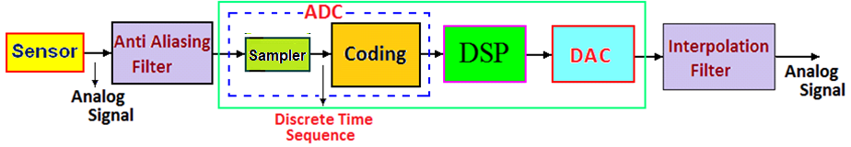
Digital Signal Processing System

Slide 5





Slide 6
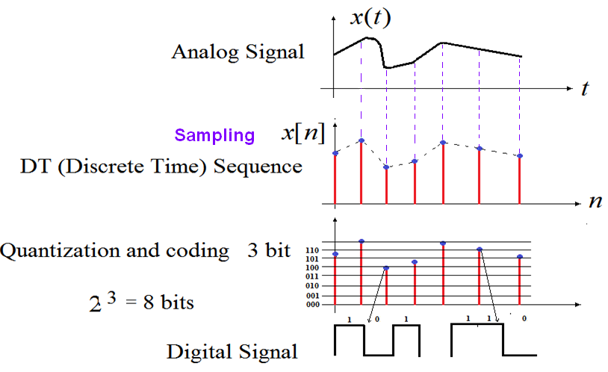
Analog, Discrete Time and Digital Signals

Slide 7
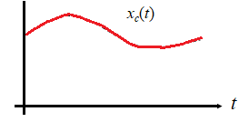
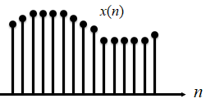
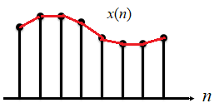
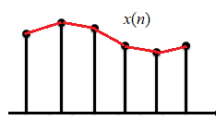
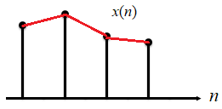
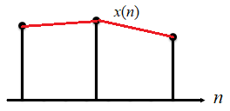
How many samples to be taken for given a signal,so that the original signal can recovered exactly?
Is there any rule?

Slide 8
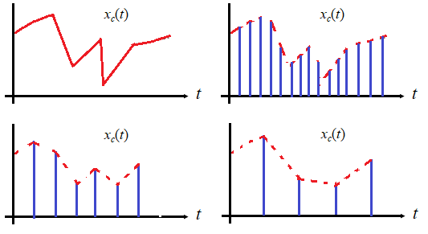
How many samples to be taken for given a signal,so that the original signal can recovered exactly?
Is there any rule?

Slide 9
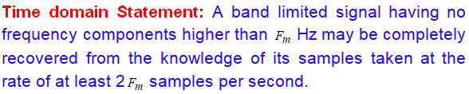
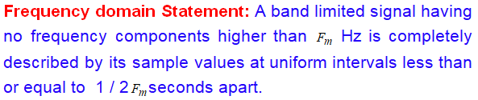
Uniform Sampling Theorem
The sampling theorem is significant in communication systems because it provides the basis for transmitting analog signals by use of digital techniques.

Slide 10
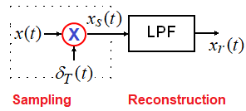
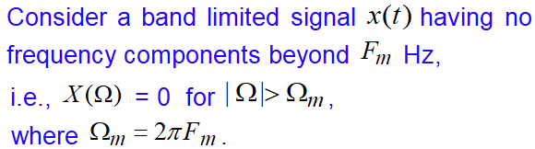
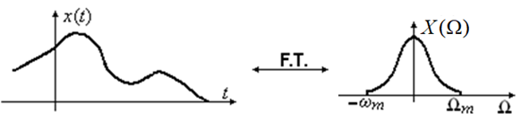

Slide 11









Slide 12
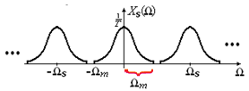




?

Slide 13
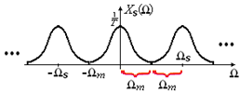


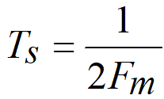


Slide 14
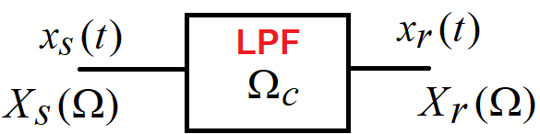




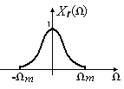
Signal Recovery from its samples

Slide 15
Under Sampling

Slide 16
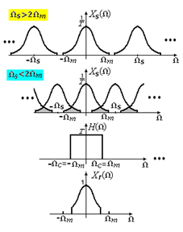

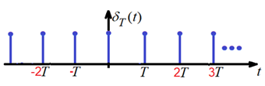
Under Sampling
Aliasing effect /
frequency folding effect

Slide 17
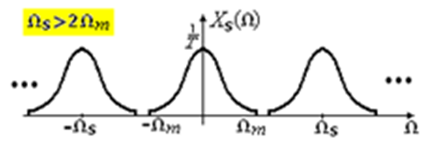

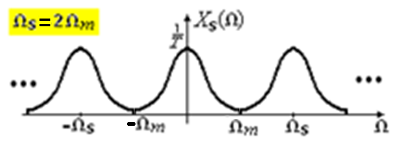

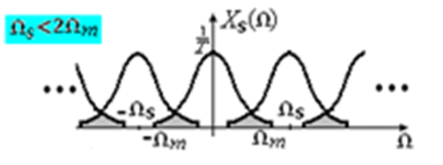

Over Sampling
Critical Sampling
Under Sampling
Aliasing

Slide 18

Uniform Sampling Theorem
In practice
In practice

Slide 19





Problems Discussion

Slide 20
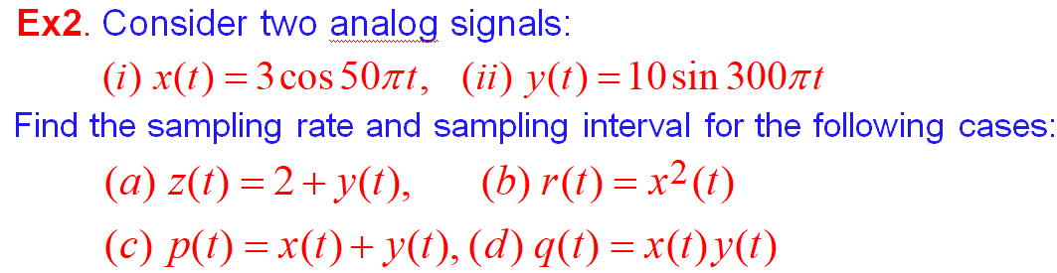








Slide 21







Slide 22
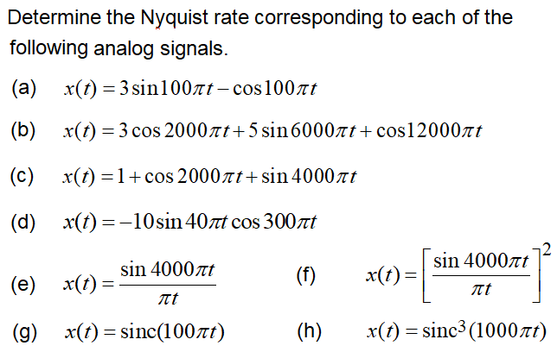

Slide 24
End

